Slide 1
identifying patterns and trends in campus placement data using machine learning

Slide 2
Team Members
Sarathy.K
Aravind Kumar.P
Jebastin.J
Logeshwaran.T

Slide 3
Introduction
Now a days the number of educational institutes isgrowing day by day. The aim of each higher educationalinstitute is to help their students to get a well-paid job throughtheir placement cell. One of the biggest challenges that higherlearning institutes face these days is to uplift the placement performance of scholars.
The goal of this system is to predict whether the studentwill get a campus placement or not based on various parameters such as gender, SSC percentage, HSC percentage,HSC stream, degree percentage, degree type, work experience& e-test percentage.

Slide 4
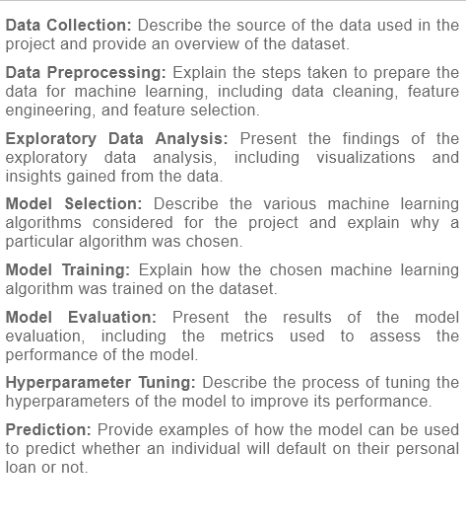
Machine Learning

Slide 5
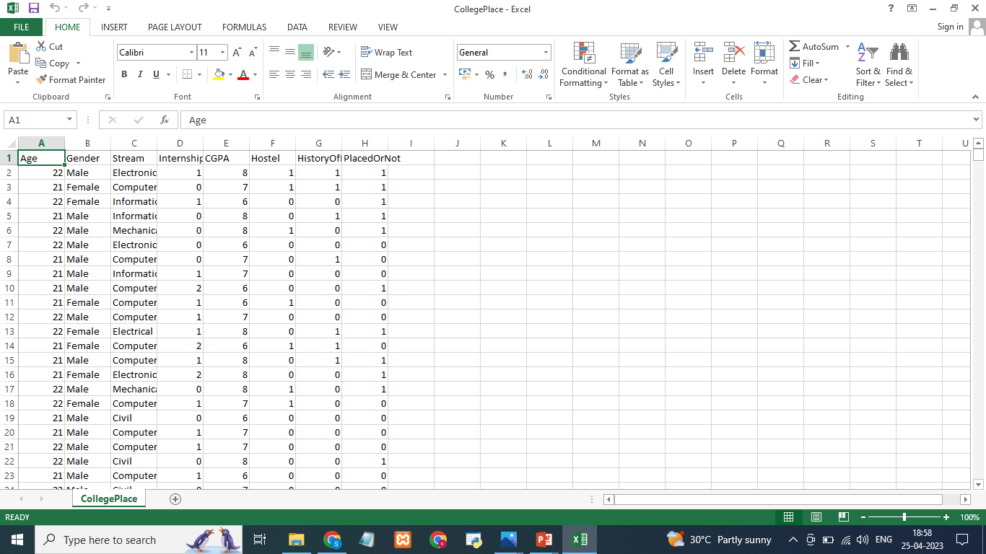
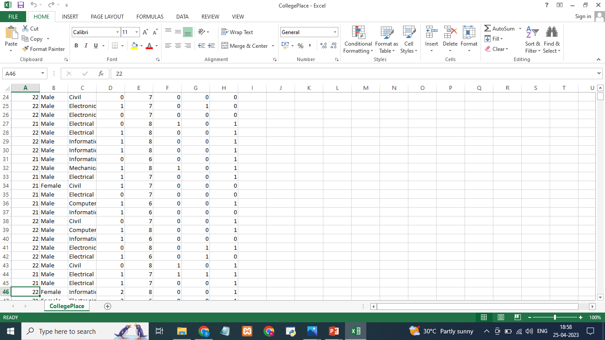
Dataset: In this project we have used .csv data. This data is downloaded from kaggle.com. Please refer to the link given below to download the dataset.

Slide 6
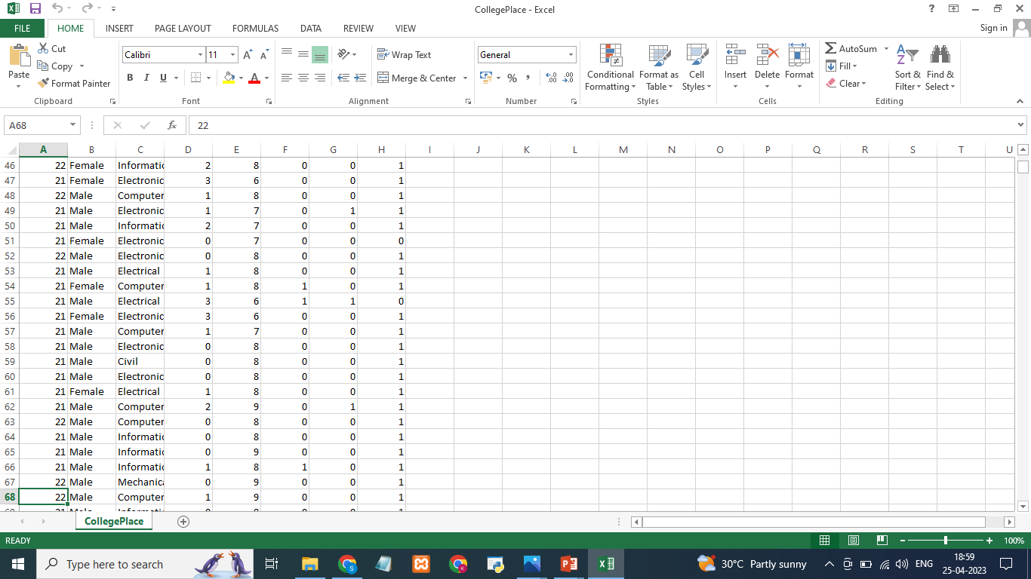
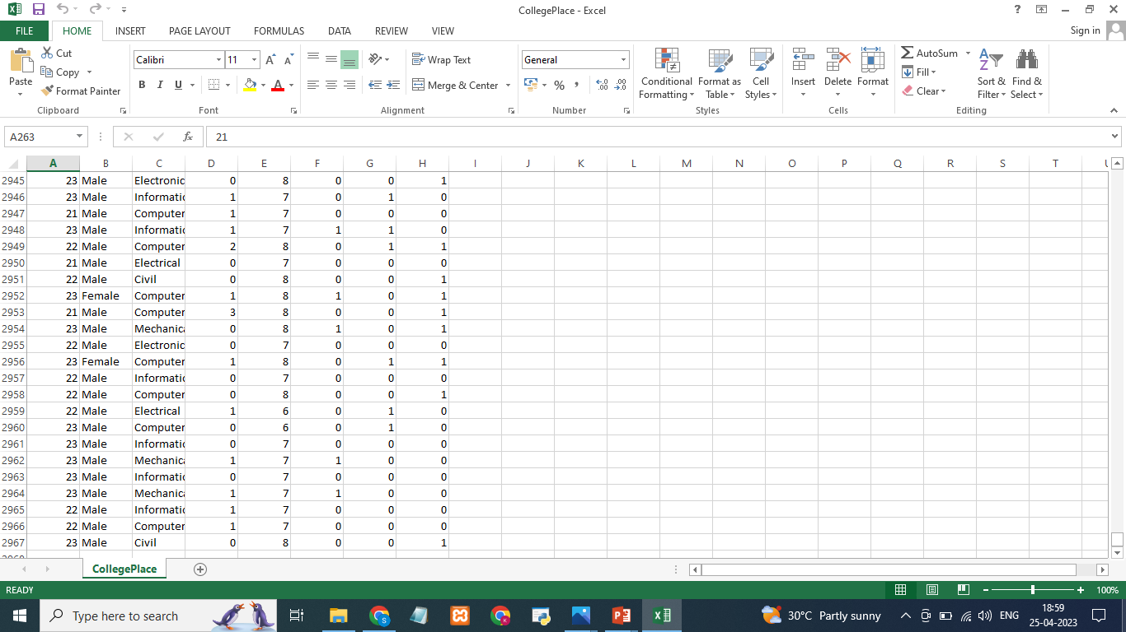

Slide 7
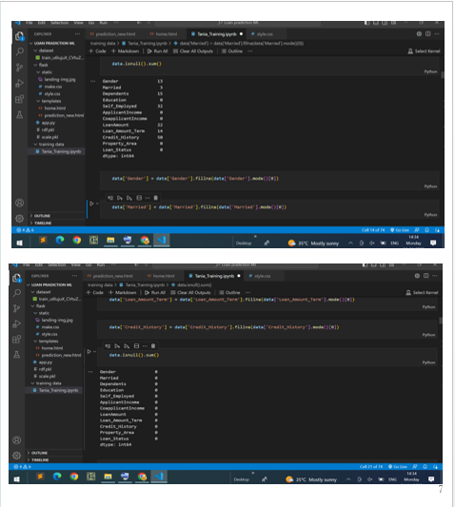
Data Preprocessing
As we have understood how the data is, let's pre-process the collected data.
The download data set is not suitable for training the machine learning model as it might have so much randomness so we need to clean the dataset properly in order to fetch good results. This activity includes the following steps.
Handling missing values
Handling categorical data
Handling Imbalance Data

Slide 8
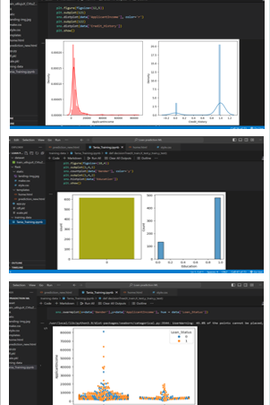
Exploratory Data Analysis
Descriptive Statistical: Descriptive analysis is to study the basic features of data with the statistical process. Here pandas has a worthy function called describe. With this describe function we can understand the unique, top and frequent values of categorical features. And we can find mean, std, min, max and percentile values of continuous features.
Visual Analysis: Visual analysis is the process of using visual representations, such as charts, plots, and graphs, to explore and understand data. It is a way to quickly identify patterns, trends, and outliers in the data, which can help to gain insights and make informed decisions.
Univariate Analysis: In simple words, univariate analysis is understanding the data with a single feature. Here we have displayed two different graphs such as distplot and countplot.
Bivariate analysis: Bivariate analysis is a statistical method that involves the analysis of the relationship between two variables. In other words, it is the study of the relationship between two variables to determine whether there is a correlation between them or not.
Multivariate Analysis: In simple words, multivariate analysis is to find the relation between multiple features. Here we have used a swarm plot from the seaborn package.

Slide 9
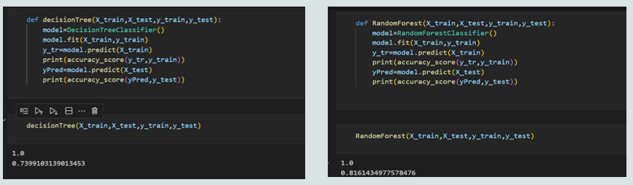
MODELSELECTION Decision Tree Model: A function named decisionTree is created and train and test data are passed as the parameters. Inside the function, DecisionTreeClassifier algorithm is initialised and training data is passed to the model with the .fit() function. Test data is predicted with .predict() function and saved in a new variable. For evaluating the model, a confusion matrix and classification report is done. Random Forest Model: A function named randomForest is created and train and test data are passed as the parameters. Inside the function, RandomForestClassifier algorithm is initialised and training data is passed to the model with .fit() function. Test data is predicted with .predict() function and saved in a new variable. For evaluating the model, a confusion matrix and classification report is done.

Slide 10
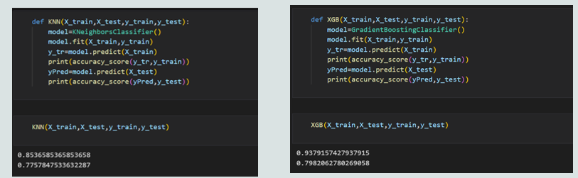
KNN Model: A function named KNN is created and train and test data are passed as the parameters. Inside the function, KNeighborsClassifier algorithm is initialised and training data is passed to the model with .fit() function. Test data is predicted with .predict() function and saved in new variable. For evaluating the model, confusion matrix and classification report is done. Xgboost Model: A function named xgboost is created and train and test data are passed as the parameters. Inside the function, GradientBoostingClassifier algorithm is initialised and training data is passed to the model with .fit() function. Test data is predicted with .predict() function and saved in new variable. For evaluating the model, confusion matrix and classification report is done. ANN Model: Building and training an Artificial Neural Network (ANN) using the Keras library with TensorFlow as the backend. The ANN is initialised as an instance of the Sequential class, which is a linear stack of layers. Then, the input layer and two hidden layers are added to the model using the Dense class, where the number of units and activation function are specified

Slide 11
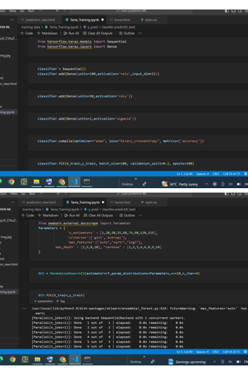
Model Evaluation
Multiple evaluation metrics means evaluating the model's performance on a test set using different performance measures. This can provide a more comprehensive understanding of the model's strengths and weaknesses. We are using evaluation metrics for classification tasks including accuracy, precision, recall, support and F1-score.

Slide 12
Conclusion
In this project, we explored the use of machine learning for predicting personal loan default. We used a dataset of historical loan data and borrower characteristics to train a machine learning model, and evaluated its performance using various metrics.
Our results show that machine learning can be a powerful tool for predicting loan default, with high accuracy rates achieved by the models. By identifying important features such as income, credit score, and loan amount, the model can help lenders to make informed decisions about loan approval and interest rates, while minimizing risk.
However, it is important to note that there are limitations to the use of machine learning in predicting personal loan default. For example, our model was trained on a specific dataset, and may not generalize well to other datasets or populations. Additionally, the model may not account for factors such as changes in economic conditions or unexpected life events that could impact borrower behavior.

